Slide 1
2012 Greater Fargo-Moorhead Community Health Needs Assessment of Residents
Results of an April 2012 Survey of Cass County, North Dakota and Clay County, Minnesota Residents

Slide 2
Introduction
  Purpose
    To learn about residents’ perceptions of the prevalence of disease and health issues in the F-M metro community
    Results are generalizable

Slide 3
Study Design and Methodology
Study Design
  Developed in collaboration with Fargo-Moorhead Community Health Needs Assessment Collaborative (FMCHNAC)
  Scannable mail survey – contained 27 questions
  Questions focused on:
    Community assets/best things about the community
    General concerns about the community
    Health and wellness concerns about the community
    Personal health care information
    Demographic information
Methodology
  Sent to 1,500 randomly selected households in Cass and Clay counties
    236 completed surveys returned for a response rate of 17%
      Generalizable sample; confidence level of 95% with an error rate of +/- 6%
Approved by the Institutional Review Board at North Dakota State University

Slide 4
Key Findings
Community Assets/Best Things About the Community
High levels of agreement that community:
  Has quality educational opportunities and institutions
  Is a good place to raise kids
  Had quality school systems and programs for youth
  Has quality health care
  Is a healthy place to live
Agreed the least that:
  There is tolerance, inclusion, and open-mindedness

Slide 5
Key Findings
General Concerns about the Community
Highest levels of concern were for:
  The aging population
  Safety issues
  Economic issues
  Issues relating to children and youth
Least concerned about:
  Environmental issues

Slide 6

Key Findings
Most concern for:
The aging population
  Availability/cost of long-term care
  Availability of resources to help elderly stay in their homes
  Availability of resources for family and friends caring for elders

Slide 7

Key Findings
Most concern for:
Safety issues
  Presence and influence of drug dealers
  Domestic violence
  Property crimes
  Child abuse and neglect

Slide 8

Key Findings
Most concern for:
Economic issues
  Employment opportunities, economic disparities between higher and lower classes
  Cost of living

Slide 9

Key Findings
Most concern for:
Children and youth
  Bullying
  Availability/cost of quality child care

Slide 10
Key Findings
Health and Wellness Concerns About the Community
Highest levels of concern were for:
  Cost and access issues
  Physical and mental health issues
Least concerned about:
  Distance to health care services

Slide 11

Key Findings
Most concern for:
Cost and access issues
  The cost of health insurance
  The cost of health care
  The cost of prescription drugs
  The adequacy of health insurance coverage
  Access to health insurance coverage

Slide 12

Key Findings
Most concern for:
Physical and mental health
  Cancer
  Chronic disease
  Obesity
  Stress

Slide 13
SURVEY RESULTS

Slide 14
Survey Results
Community Assets/Best Things About
Their Community
People
Services and Resources
Quality of Life

Slide 15
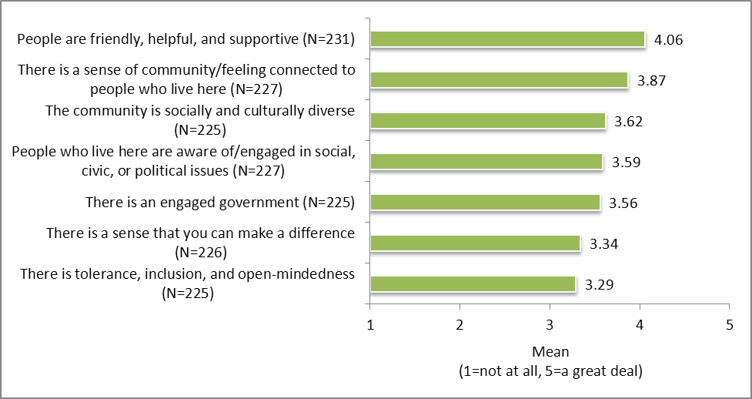
Respondents’ level of agreement with statements about their community regarding PEOPLE
Respondents agree most that:
  People in their community are friendly, helpful, and supportive
  There is a sense of community or feeling connected to people who live here
Respondents agree least that:
  There is tolerance, inclusion, and open-mindedness (although still a moderate level of agreement)

Slide 16
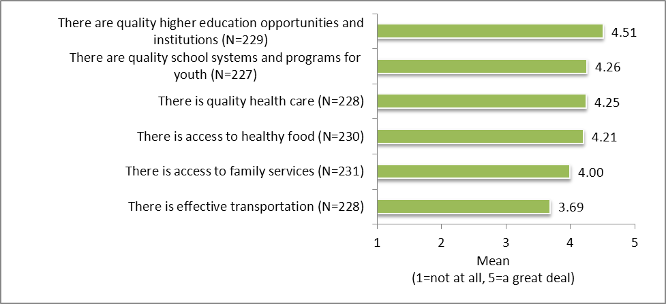
Respondents’ level of agreement with statements about their community regarding
SERVICES AND RESOURCES
Respondents agree most that:
  There are quality higher education opportunities and institutions
  There are quality school systems and programs for youth
  There is quality health care
Respondents agree the least that:
  There is effective transportation (although still moderately high level of agreement)

Slide 17
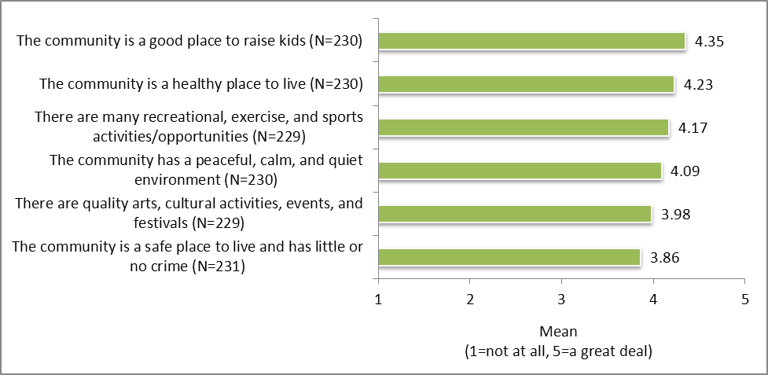
Respondents’ level of agreement with statements about their community regarding QUALITY OF LIFE
Respondents agree most that:
  Their community is a good place to raise kids
  Their community is a healthy place to live
Respondents agree least that:
Their community is a safe place to live and has little or no crime (although still a moderately high level of agreement)

Slide 18

Survey Results
General Concerns About Their Community
Economic Issues
Transportation
Environment
Children and Youth
The Aging Population
Safety

Slide 19
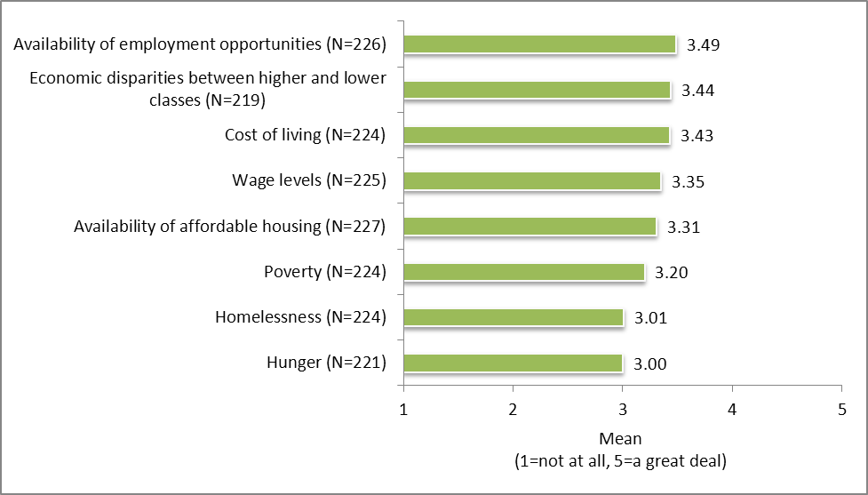
Respondents’ level of concern with statements about their community regarding ECONOMIC ISSUES
Respondents are most concerned about:
  Availability of employment opportunities
  Economic disparities between higher and lower classes
  Cost of living
Respondents are least concerned about: (although still moderately concerned)
  Hunger
  Homelessness

Slide 20
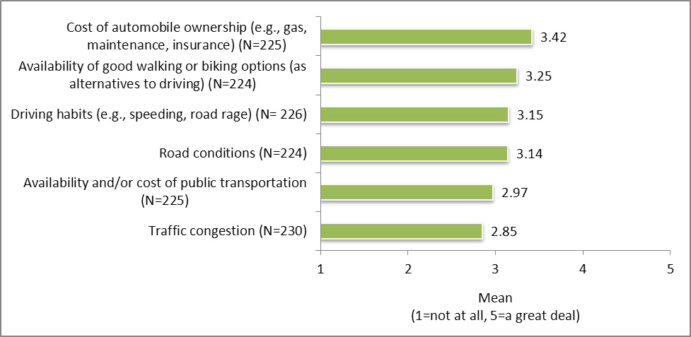
Respondents’ level of concern with statements about their community regarding TRANSPORTATION
Respondents are most concerned about:
  The cost of automobile ownership
  The availability of good walking or biking options
Respondents are least concerned about:
  Traffic congestion (although still moderately concerned)

Slide 21
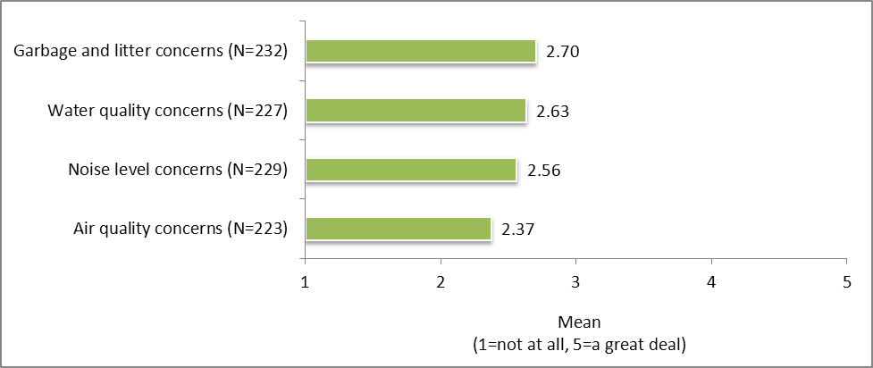
Respondents’ level of concern with statements about their community regarding ENVIRONMENT
Overall, respondents are not that concerned with environmental issues
Respondents have a higher level of concern with garbage and litter than with water quality, noise level, and air quality issues

Slide 22
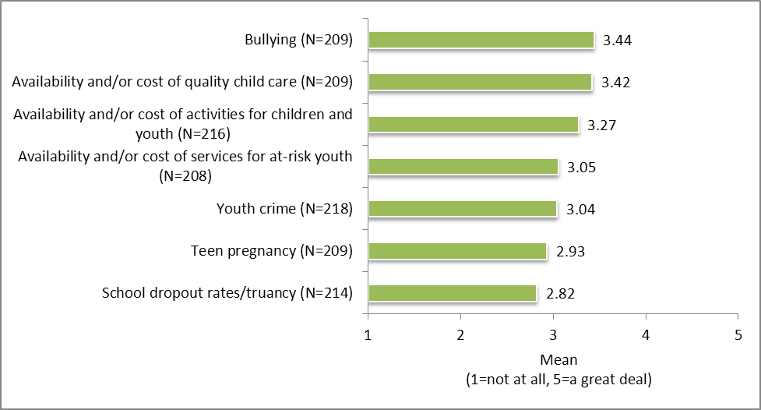
Respondents’ level of concern with statements about their community regarding CHILDREN AND YOUTH
Respondents are most concerned about:
  Bullying
  Availability and/or cost of quality child care
Respondents are least concerned about:
School dropout rates and truancy (although still moderately concerned)

Slide 23
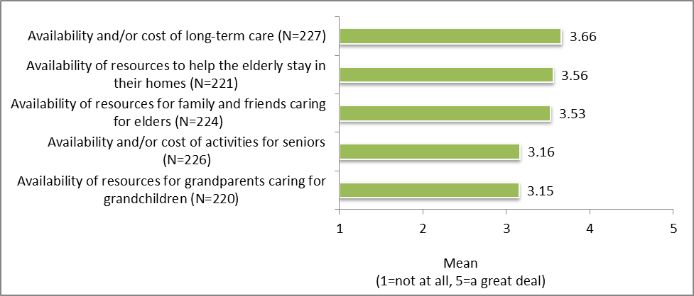
Respondents’ level of concern with statements about their community regarding THE AGING POPULATION
Respondents are most concerned about:
  The availability and cost of long-term care
  The availability of resources to help the elderly stay in their homes
  The availability and cost for family and friends caring for elders
Respondents are least concerned about: (although still moderately concerned)
The availability of resources for grandparents caring for grandchildren
The availability or cost of activities for seniors

Slide 24
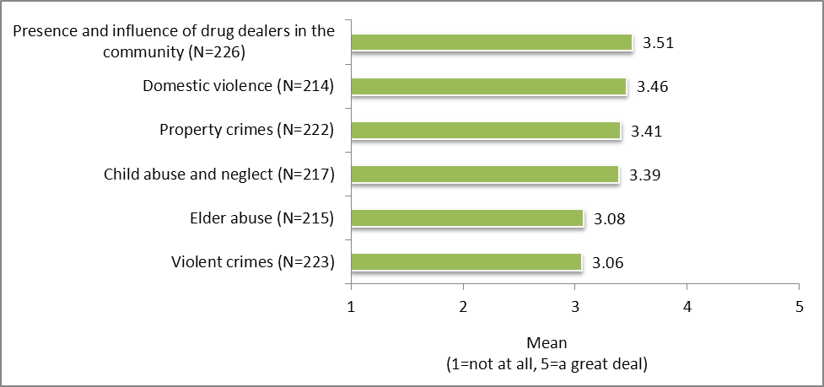
Respondents’ level of concern with statements about their community regarding SAFETY
Respondents are most concerned about:
  Presence and influence of drug dealers
  Domestic violence
  Property crimes
  Child abuse and neglect
Respondents are least concerned about: (although still moderately concerned)
Violent crimes
Elder abuse

Slide 25
Survey Results
Health and Wellness Concerns About Their Community
Access to health care
Physical and mental health
Substance use and abuse

Slide 26
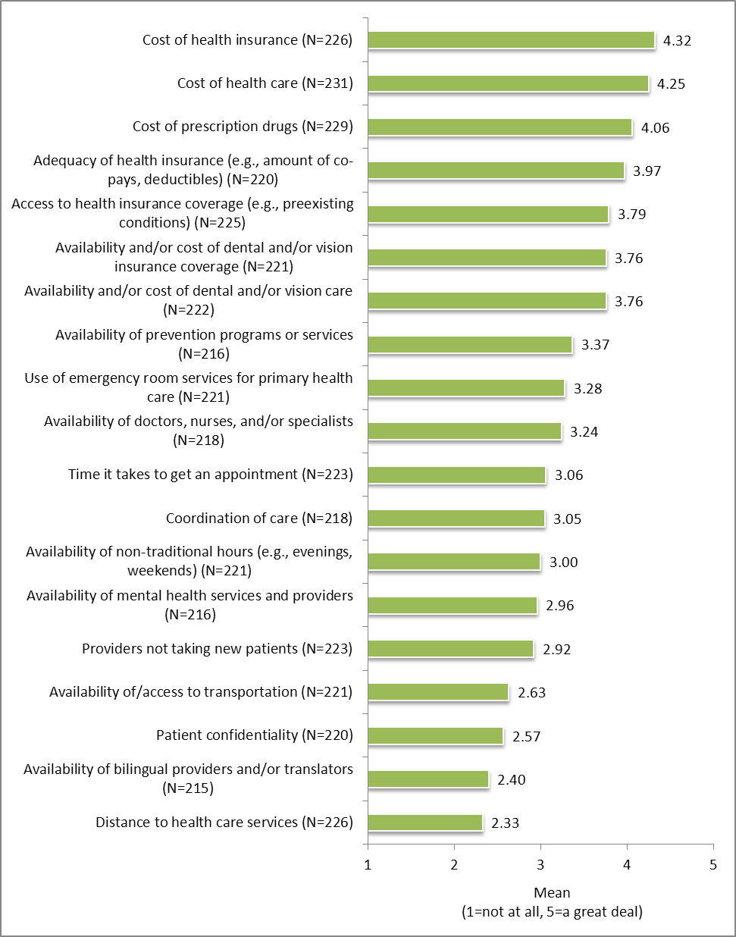
Respondents’ level of concern with statements about their community regarding ACCESS TO HEALTH CARE
Respondents are most concerned about:
  Cost of health insurance
  Cost of health care
  Cost of prescription drugs
  Adequacy of health insurance (e.g., amount of copays, deductibles)
Respondents have moderately high levels of concern about:
  Access to health insurance coverage of dental and/or (e.g., preexisting conditions)
  Availability and/or cost of dental and/or vision insurance coverage
  Availability and/or cost vision care
Respondents are least concerned about:
    Distance to health care services
    Availability of bilingual providers and/or translators
    Patient confidentiality
  Availability of/access to transportation

Slide 27
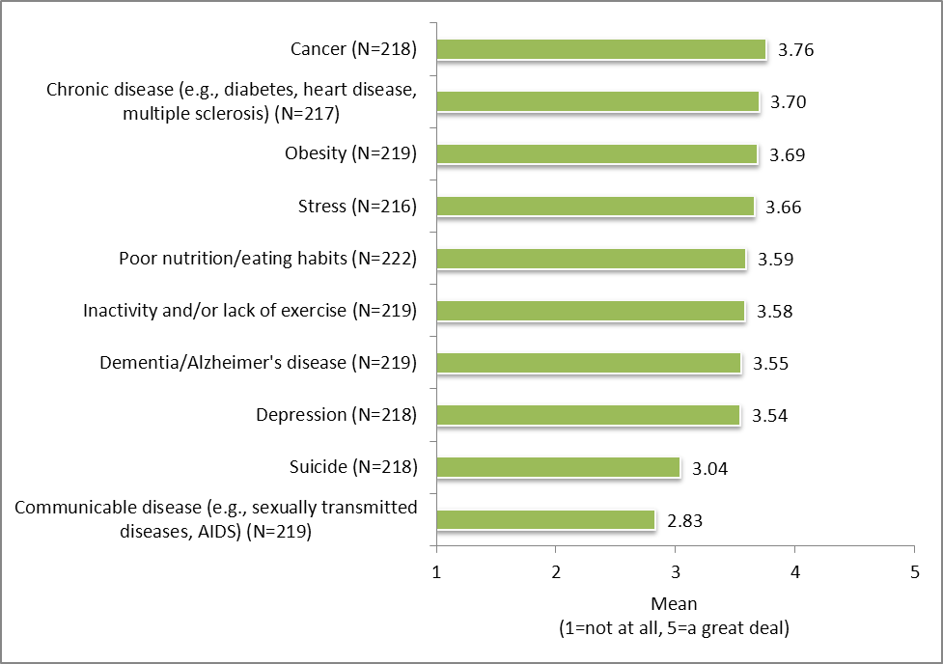
Respondents’ level of concern with statements about their community regarding
PHYSICAL AND MENTAL HEALTH
Respondents are most concerned about:
  Cancer
  Chronic disease
  Obesity
  Stress
Respondents are least concerned about: (although still moderately concerned)
  Suicide
  Communicable disease

Slide 28
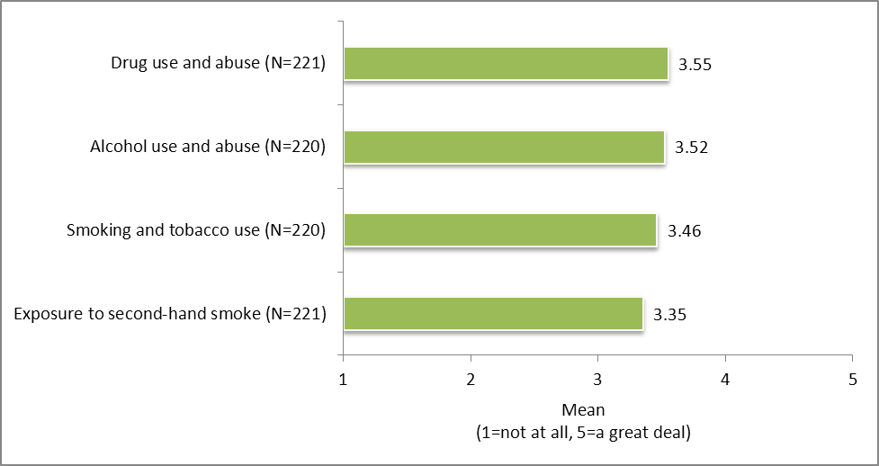
Respondents’ level of concern with statements about the community regarding SUBSTANCE USE AND ABUSE
Respondents’ levels of concern regarding substance use and abuse are very similar and moderately high

Slide 29


Personal Health Care Information

Slide 30
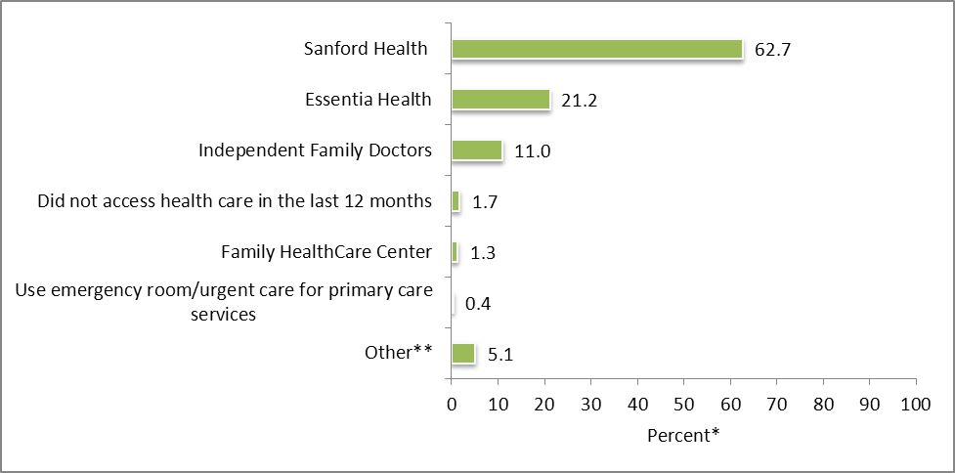
Respondents’ primary health care provider
Three in five respondents use Sanford Health
One in five respondents use Essentia Health
N=236
*Percentages do not equal 100.0 due to multiple responses.

Slide 31
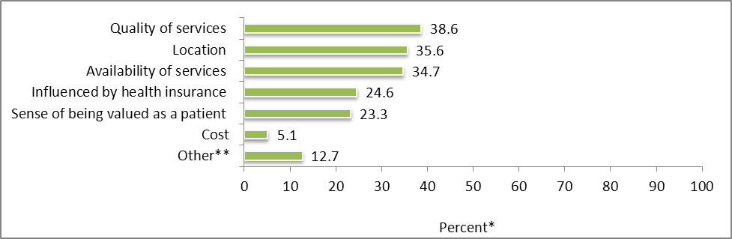
Respondents’ reasons for choosing primary health care provider
Top three reasons:
  Quality of services
  Location
  Availability of services
Cost is not an issue for most respondents
N=236
*Percentages do not equal 100.0 due to multiple responses.

Slide 32
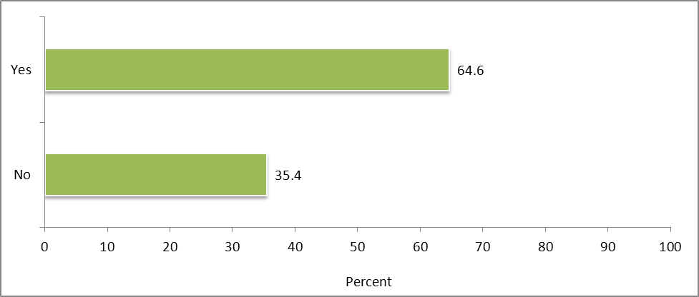
Whether respondents had a cancer screening or cancer care in the past year
One in three respondents have not had a cancer screening or cancer care in the past year
N=223

Slide 33
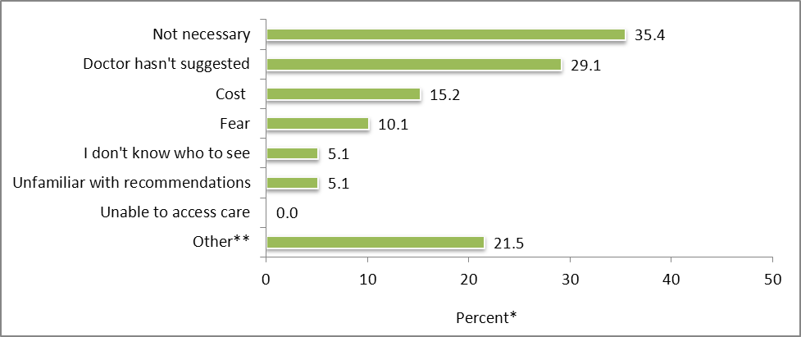
Among respondents who have not had a cancer screening or cancer care in the past year, reasons for not having done so
35.4% said it was not necessary
29.1% said doctor had not suggested it
15.2% said cost
10.1% said fear
Other reasons
  Not due to have a screening (5)
  Have chosen not to screen (3)
N=79
*Percentages do not equal 100.0 due to multiple responses.

Slide 34
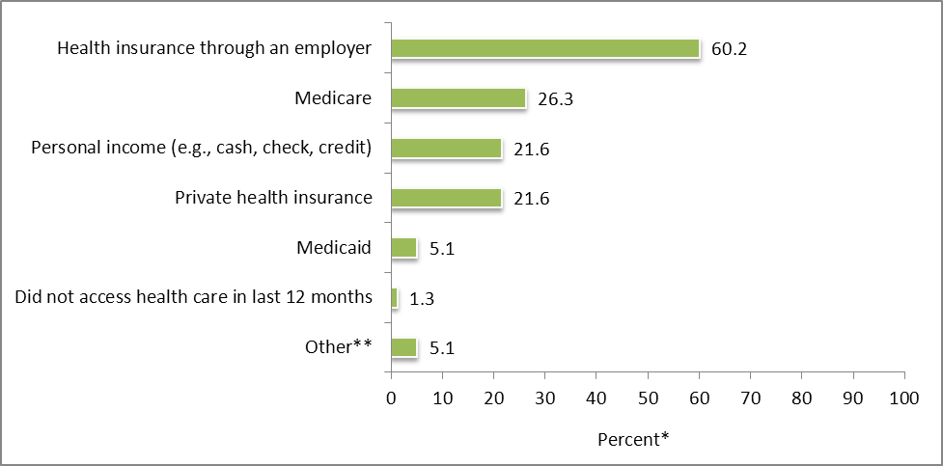
Methods respondents have used to pay for health care costs over the last 12 months
The majority of respondents paid with health insurance through an employer
26.3% used Medicare
26.1% used personal income
26.1% used private health insurance
N=236
*Percentages do not equal 100.0 percent due to multiple responses.

Slide 35

Demographic Information

Slide 36
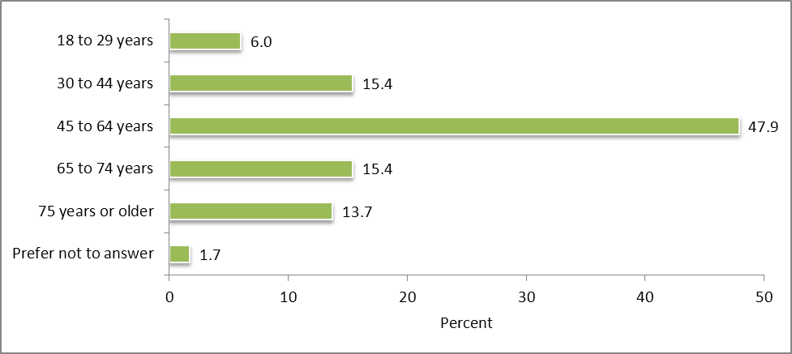
Respondents’ age
The majority of respondents are
45 to 64 years
29.1% are
65 years or older
N=234

Slide 37
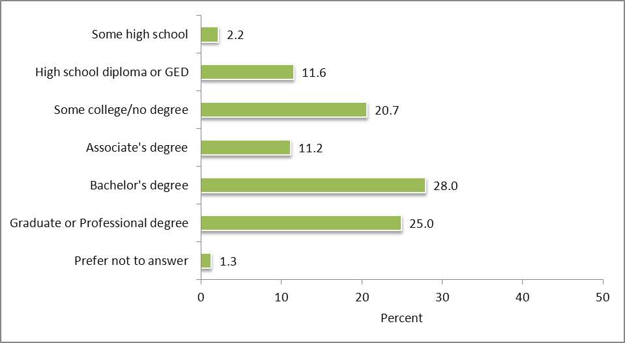
Respondents’ highest level of education
The majority of respondents have a Bachelor’s degree or higher
  Includes 25% who have a Graduate or Professional degree
1 in 10 have, at most, a high school diploma or GED
N=232

Slide 38
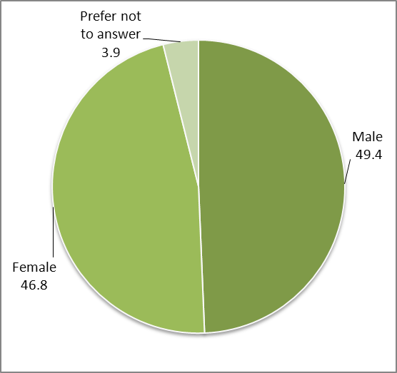
Respondents’ gender
The gender distribution among respondents is evenly split between males and females
N=233

Slide 39
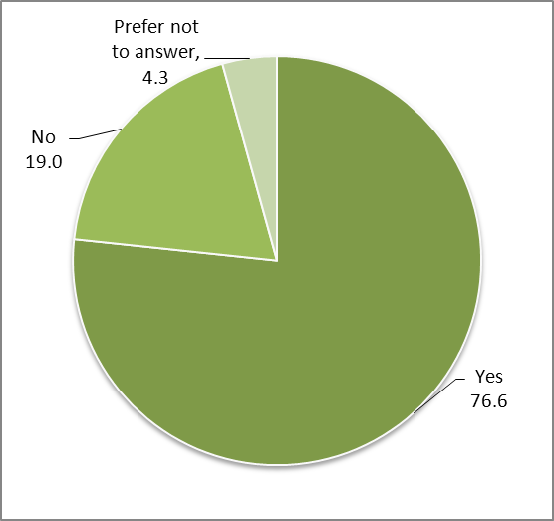
Whether respondents work/volunteer outside the home
Three in four respondents said they work or volunteer outside their home
N=231

Slide 40
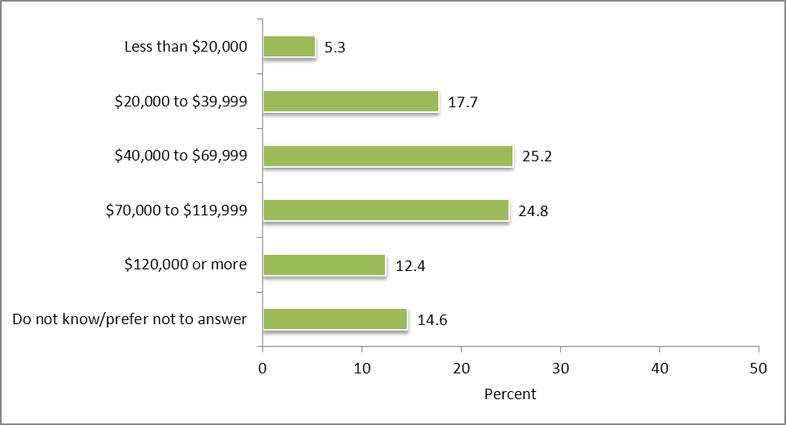
Respondents’ annual household income before taxes
Among respondents:
  25% have an annual household income of $40,000 to $69,999
  25% have an annual household income of $70,000 to $119,999
  5% earn less than $20,000 annually
N=226

Slide 41
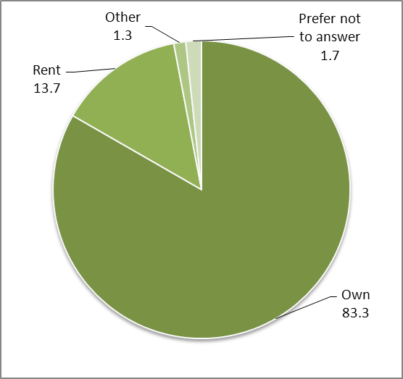
Whether respondents own or rent their home
Vast of majority of respondents own their home
N=234

Slide 42
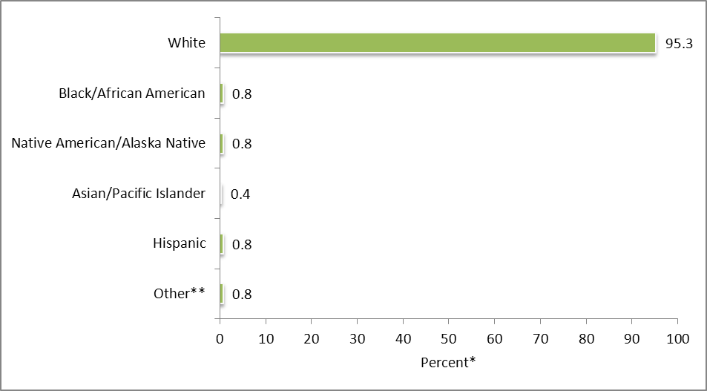
Respondents’ race or ethnicity
Vast majority of respondents are white
N=236
*Percentages do not equal 100.0 due to multiple responses.

Slide 43
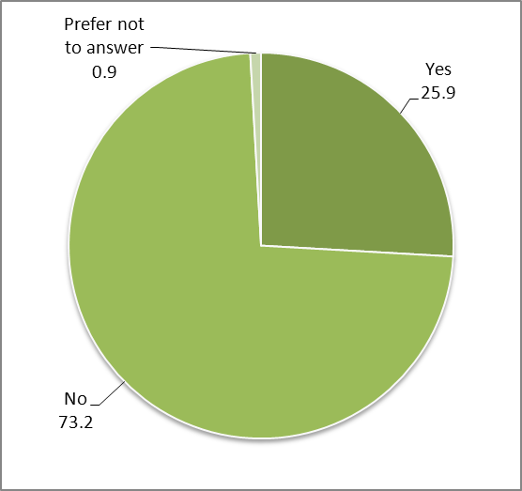
Whether respondents are the parent or primary caregiver of a child or children
18 years of age or younger
One in four respondents are the parent or primary caregiver of a child or children 18 years of age or younger
N=228

Slide 44
Companion Report Comparisons
2012 Greater Fargo-Moorhead Community Health Needs Assessment of Residents & 2012 Greater Fargo-Moorhead Community Health Needs Assessment of Community Leaders

Slide 45
Comparisons
(caution should be used when interpreting the comparisons as findings from the community leaders’ survey are not generalizable to the community)
Residents
Community Leaders
Overall lower levels of agreement and concern than leaders
Overall higher levels of agreement and concern than residents

Slide 46
Community Assets
Residents
Community Leaders
Agree most that
  There are quality higher education opportunities, institutions, school systems, and programs for youth
  There is quality health care
  It is a good place to raise kids
Agree less (than leaders) that
  There is an engaged government
  There is a sense you can make a difference
Agree the least that
  There is tolerance, inclusion, and open-mindedness
Agree most that
  There are quality higher education opportunities, institutions, school systems, and programs for youth
  There is quality health care
  It is a good place to raise kids
Agree more (than residents) that
  There is an engaged government
  There is a sense you can make a difference
Agree the least that
  There is effective transportation

Slide 47
General Concerns
Residents
Community Leaders
Top concerns directed at aging population
Also among top concerns
  Availability of employment opportunities
  Presence and influence of drug dealers
Least concerned about
  Garbage and litter
  Water and air quality
  Noise levels
Top concerns directed at aging population
Most concerned about domestic violence
Also among top concerns
  Availability of quality child care
  Bullying
Least concerned about
  Garbage and litter
  Water and air quality
  Noise levels

Slide 48
Health and Wellness Concerns
Residents
Community Leaders
Top concerns are access-related issues
  Cost of health insurance and health care
  Cost of prescription drugs
Physical and mental health top concerns
  Cancer
  Chronic disease
  Obesity
Least concerned about
  Communicable disease
  Suicide
Top concerns are access-related issues
  Cost of health insurance and health care
  Cost of prescription drugs
Physical and mental health top concerns
  Obesity
  Poor nutrition and eating habits
  Inactivity or lack of exercise
Least concerned about
  Communicable disease
  Suicide

